Slide 2
Inclusive Naming Initiative:
general meeting
(FYI: This is streaming to twitch!)

Slide 3








Intro: Inclusive Naming Initiative
Cross-organizational Collaboration
inclusivenaming.org
Focused on providing meaningful assistance to the critical mass of enthused open source projects and other codebases to make language changes in a thoughtful way that is in sync with the rest of the ecosystem so that we all only have to Do It Once! ™

Slide 4
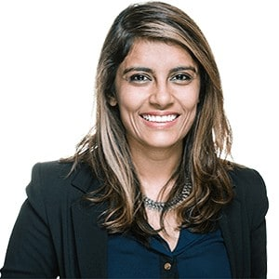
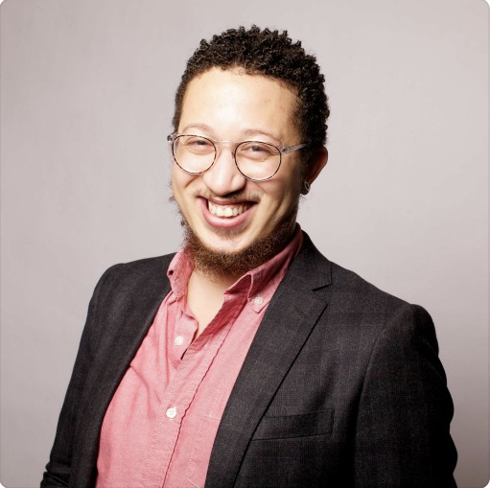
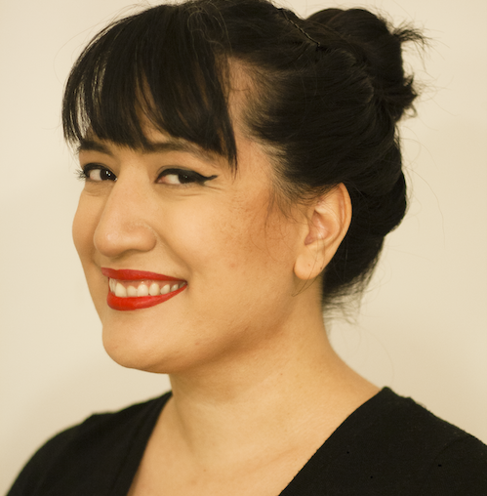
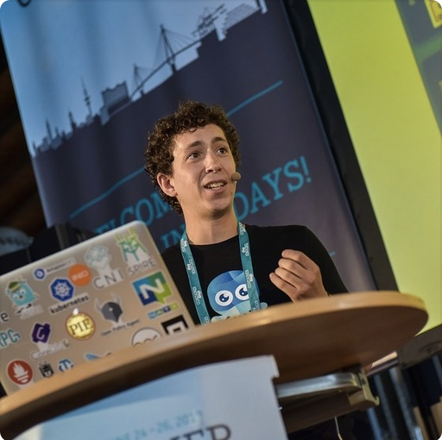
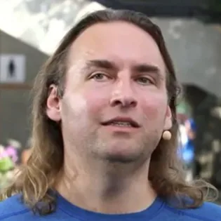
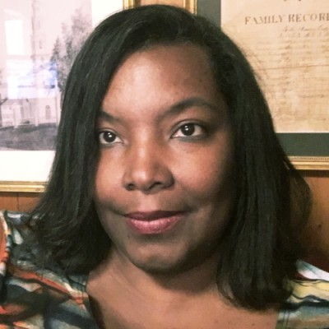
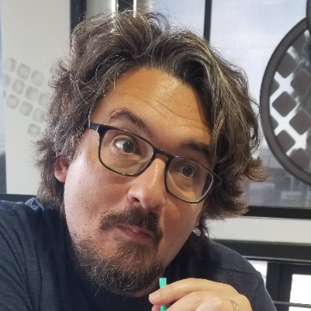
Founders
Priyanka Sharma
General Manager, CNCF
Stephen Augustus
Head of Open Source, Cisco
Celeste Horgan
Senior Technical Writer, CNCF
Bill Mulligan
Marketing Manager, CNCF
Ed Warnicke
Distinguished Engineer, Cisco
Dale Davis Jones
VP & Distinguished Engineer, IBM
Jason Brooks
OSPO Manager, Red Hat

Slide 5
Our goal
Enable the industry to
remove harmful and unclear language and replace it with an agreed-upon set of neutral terms by providing tangible tools and recognition

Slide 6
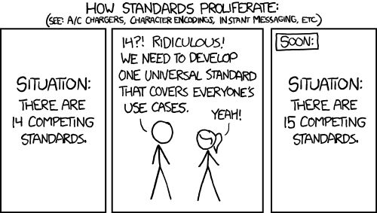
How we’re doing it
Trying to get everyone in the same room to drive consensus-based understanding of replacement terms and support organizations trying to make these changes.

Slide 7
What’s happened since last KubeCon?
Formed workstreams
Work happens in specialized workstreams
Worked on governance models
Governance itself
Code of Conduct
Defined deliverables and responsibilities for each workstream

Slide 8
Get involved: in general
Slack: Inclusive Naming Initiative
(get an invite: https://communityinviter.com/apps/inclusive-naming/invite)
Mailing list: inclusivenaming@googlegroups.com
with a Google account: https://groups.google.com/u/2/g/inclusivenaming
without a Google account – send an email to inclusivenaming+subscribe@googlegroups.com
Meetings: Every 2nd Monday @ 9:15am - 10am PST (see on the meeting calendar: https://inclusivenaming.org/calendar/ and join the mailing list for an invite)

Slide 9
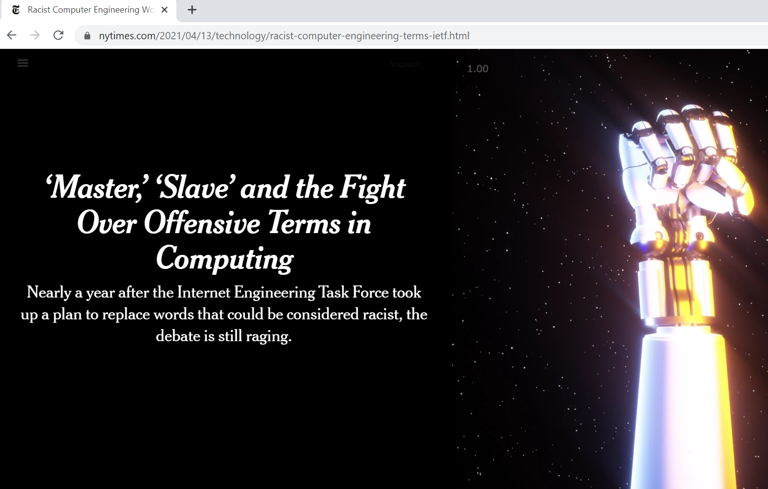

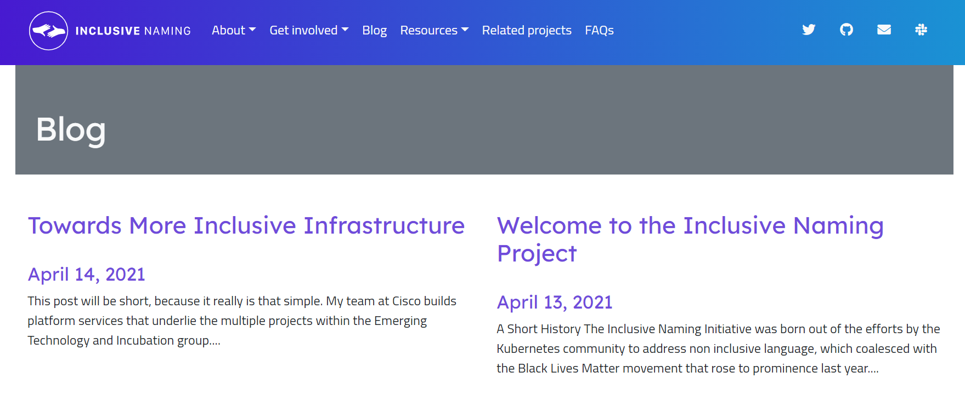
.. We also got some press!
NYT
FastCo
Blog posts!

Slide 10
WS Language
Leads:
Celeste Horgan, CNCF
Larry Kunz, Extreme Networks
Working on a list of 26 initial recommendations – later this month!
Refining our evaluation framework to represent the group’s process

Slide 11
WS Language: Get involved
Slack: Inclusive Naming Initiative #ws-language channel (get an invite: https://communityinviter.com/apps/inclusive-naming/invite)
Mailing list: ws-language@inclusivenaming.org (join: https://groups.google.com/u/1/a/inclusivenaming.org/g/ws-language)
Meetings: Every 2nd Tuesday @ 11:30am - 12pm PST (see on the meeting calendar: https://inclusivenaming.org/calendar/ and join the mailing list for an invite)

Slide 12
WS Open Source
Leads:
Stephen Augustus, Cisco
Celeste Horgan, CNCF
Dale Davis Jones, IBM
Jason Brooks, Red Hat
Accepting and housing new open source projects
Writing guidance documentation for OSS projects
Machine readable formats for the language recommendations

Slide 13
WS Open Source: Get involved
Slack: Inclusive Naming Initiative #ws-open-source channel (get an invite: https://communityinviter.com/apps/inclusive-naming/invite)
Mailing list: ws-oss@inclusivenaming.org (join: https://groups.google.com/u/2/a/inclusivenaming.org/g/ws-oss)
Meetings: Every 2nd Monday @ 10:30am - 11am PST (see on the meeting calendar: https://inclusivenaming.org/calendar/ and join the mailing list for an invite)

Slide 14
WS Company
Leads:
Andre Pellet, Dell
Monica Rush, Microsoft
Drafting a survey on working with corporate level suppliers
Leading on content guidance for companies – how does an enterprise organization make this kind of change?

Slide 15
WS Company: Get involved
Slack: Inclusive Naming Initiative #ws-company channel (get an invite: https://communityinviter.com/apps/inclusive-naming/invite)
Mailing list: ws-company@inclusivenaming.org (join: https://groups.google.com/u/2/a/inclusivenaming.org/g/ws-oss)
Meetings: Every 2nd Thursday @ 11am - 12pm PST (see on the meeting calendar: https://inclusivenaming.org/calendar/ and join the mailing list for an invite)

Slide 16
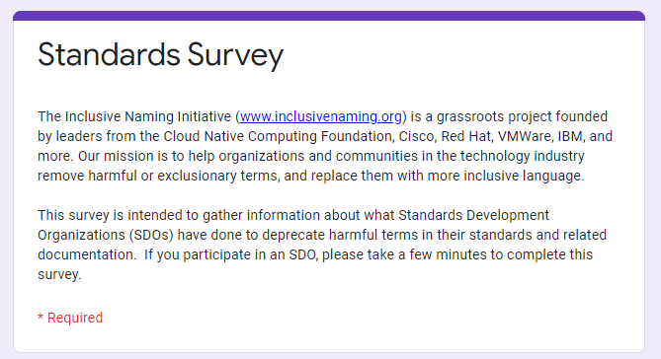
WS Standards
Leads:
Joanna Lee, Gesmer Upgrove
Matthew Schnoor, Intel
Gathering data from SDOs on their progress on the journey of replacing harmful language
Collecting and sharing resources for SDOs that need assistance
Serving as a conduit to the work that other workstreams are producing

Slide 17
WS Standards: Get involved
Slack: Inclusive Naming Initiative #ws-standards channel (get an invite: https://communityinviter.com/apps/inclusive-naming/invite)
Mailing list: ws-standards@inclusivenaming.org (join: https://groups.google.com/u/2/a/inclusivenaming.org/g/ws-standards)
Meetings: Every 2nd Thursday @ 10am - 11am PST (see on the meeting calendar: https://inclusivenaming.org/calendar/ and join the mailing list for an invite)

Slide 18
WS Marketing
Leads:
Bill Mulligan, CNCF
Priyanka Sharma, CNCF
Jim St. Leger, Intel
Twitter and LinkedIn accounts live
Blog launched
Media One pager developed
More logos added to the wall

Slide 19
WS Marketing: Get involved
Handles marketing, events, and membership for the Inclusive Naming Initiative.
Leads: Bill Mulligan, Jim St. Leger
Meeting times: Wednesday bi-weekly @ 16:30 CEST
Communication methods: Inclusive naming initiative slack : #ws-marketing

